Slide 1


Govt GNA PG COLLEGE BHATAPARA (C.G)
B.COM - 3RD SEM
Investment Overview
GROUP ASSIGNMENT
PRESENTED BY
GROUP NO - 14

Slide 2
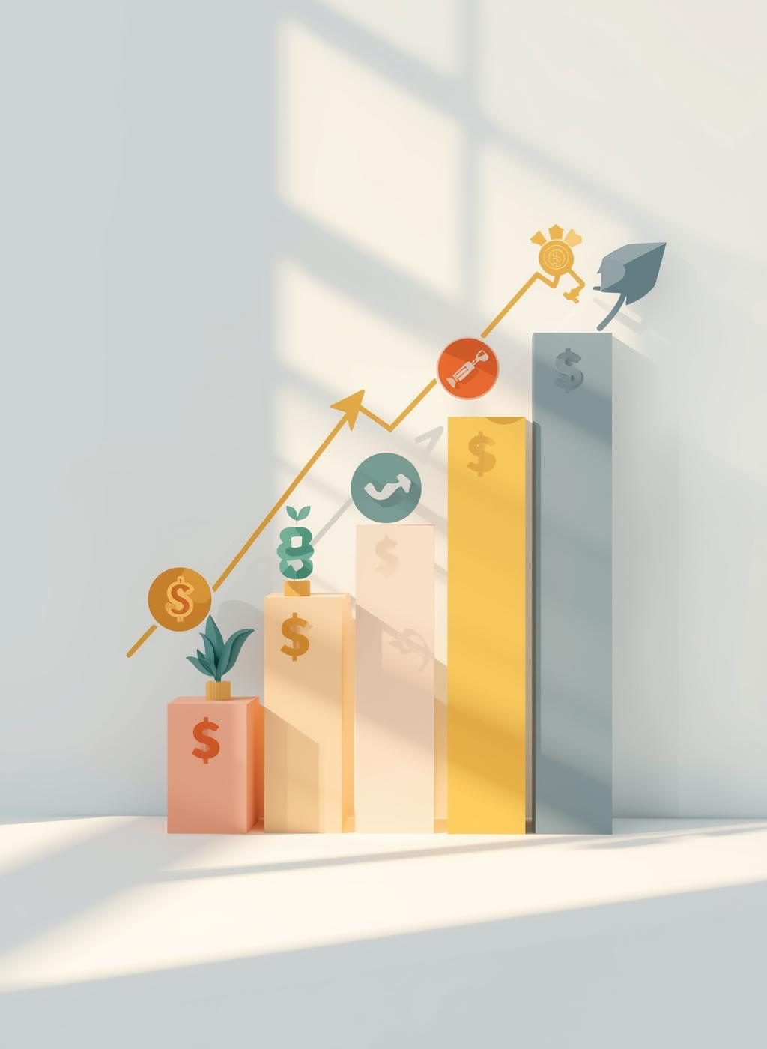
What is Investment?
Investment involves committing money or resources to generate future benefits. Understanding investment is crucial for wealth growth, income generation, and capital preservation.

Slide 3

Investment Objectives
Understanding investment objectives is crucial for making informed decisions. Key considerations include risk tolerance, time horizon, and financial goals, which shape overall investment strategies.
• Safety of capital
• Regular income
• Capital Formation
• weath creation
• Retirement security

Slide 4

Importance Of Investment
•Provides financial security
•Helps in future planning
•Fights inflation
•Generates additional income
•Builds wealth

Slide 5

Investment vs. Saving
Understanding the key differences between investment and saving is crucial for effective financial planning and achieving long-term financial goals.

Slide 6

Types Of Investment
Investments are generally divided into:
1. Financial Investments
2. Real Investments

Slide 7

Financial Investment
These are investments in financial assets such as:
•Shares
•Bonds
•Mutual Funds
•Fixed Deposits

Slide 8
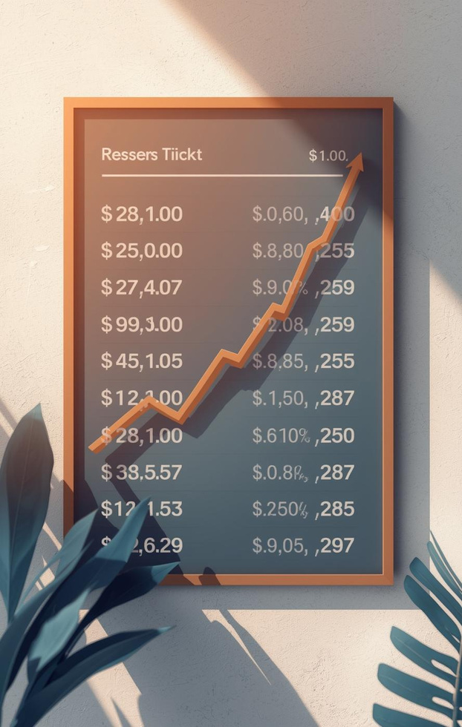

Real Investment
INVESTMENTS IN PHYSICAL OR TANGIBLE ASSETS LIKE:
•LAND
•BUILDINGS
•GOLD
•MACHINERY

Slide 9


Direct Investment
DIRECT INVESTMENT MEANS WHEN AN INDIVIDUAL OR ORGANIZATION INVESTS MONEY DIRECTLY INTO ASSETS OR BUSINESSES WITHOUT USING ANY MIDDLEMAN.

Slide 10
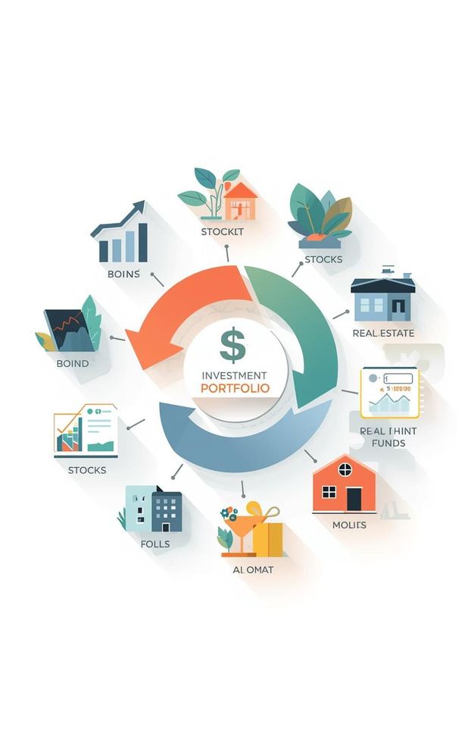


Indirect Investment
INDIRECT INVESTMENT MEANS INVESTING MONEY THROUGH A MIDDLE ORGANIZATION OR INTERMEDIARY INSTEAD OF DIRECTLY BUYING ASSETS.
THE INVESTOR’S MONEY IS MANAGED BY PROFESSIONALS WHO INVEST IT IN DIFFERENT ASSETS.
IT HELPS REDUCE RISK AND IS SUITABLE FOR PEOPLE WITH LESS KNOWLEDGE OF THE MARKET.

Slide 11

Short Term Investment
Short-term investments are made for a short duration, usually less than one year.
They provide quick returns and are easily convertible into cash.
These investments involve low risk and moderate profit.
Examples: Fixed Deposits, Treasury Bills, Money Market Funds.

Slide 12



Long-Term Investment
LONG-TERM INVESTMENTS ARE MADE FOR A LONG PERIOD, USUALLY MORE THAN ONE YEAR.
THEY HELP IN WEALTH CREATION AND FINANCIAL GROWTH OVER TIME.
THESE INVESTMENTS INVOLVE HIGHER RISK BUT OFFER GREATER RETURNS IN THE FUTURE.

Slide 13

Cryptocurrencies: Introduction
Cryptocurrencies are digital assets that utilize blockchain technology. They offer high risk and potential reward, making them an emerging asset class in modern investment portfolios.

Slide 14


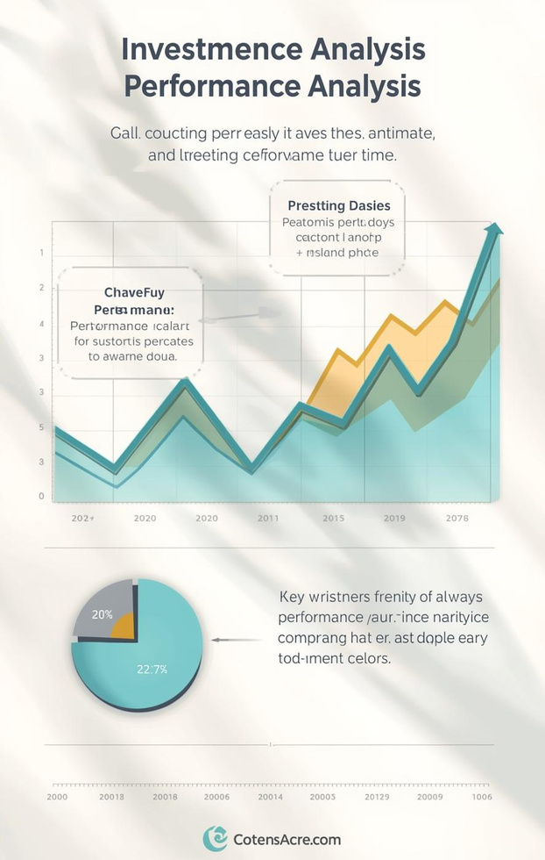
Alternative Investments: Exchange-Traded Funds (ETFs)
MARKET OVERVIEW
Stock trends
PORTFOLIO DIVERSIFICATION
Investment options
PERFORMANCE ANALYSIS
Market insights

Slide 15

Factors to Consider
Understanding risk tolerance and investment goals is essential for successful investing. By assessing these factors, you can create a more effective strategy tailored to your financial objectives.

Slide 16

Notes:
Write conclusion of investment

